Slide 1
Quantitative models for Decision makers
A presentation by Team
Five guys Fries

Slide 2



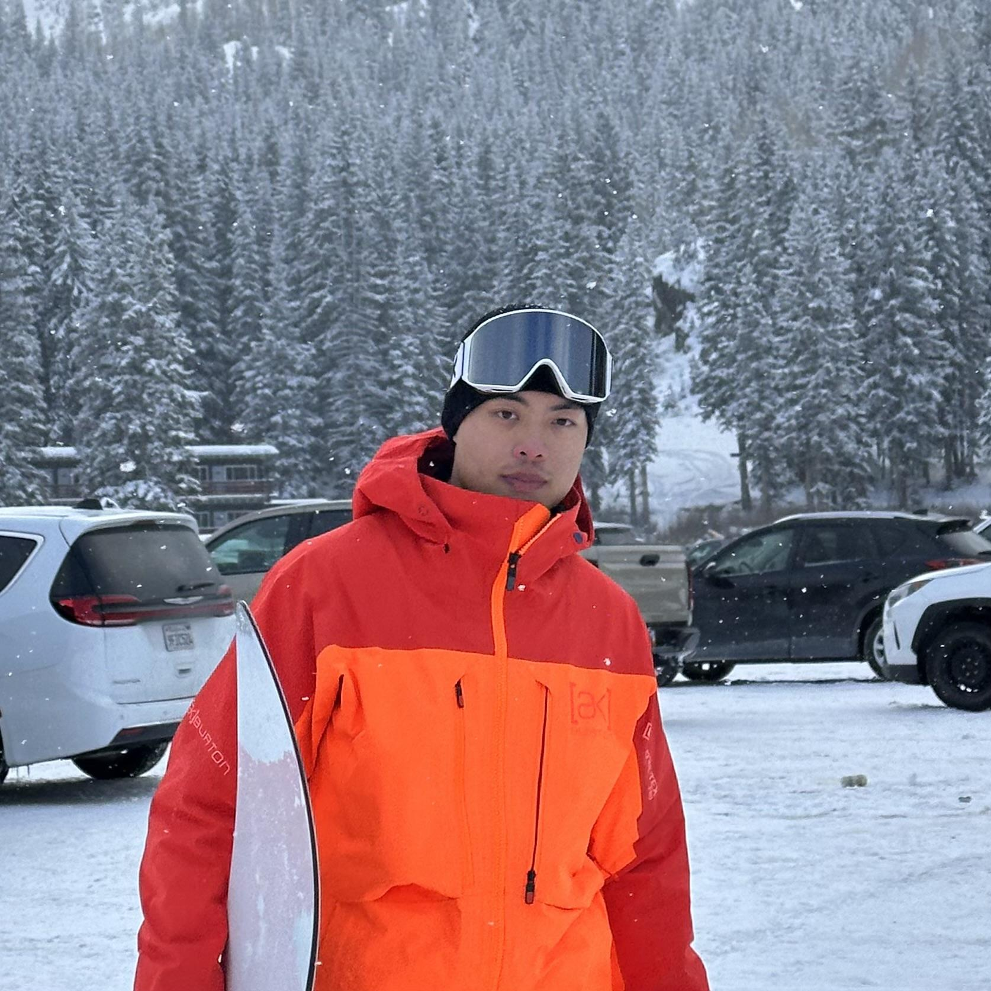

Meet our team
Shreya Shreya
Linghong Huang
Margret Lam
Pai Liu
Miaoer Cheng

Slide 3
Case 1
Case Title: Production Strategy
Chapter: 2
Chapter Title: An Introduction to Linear Programming

Slide 4
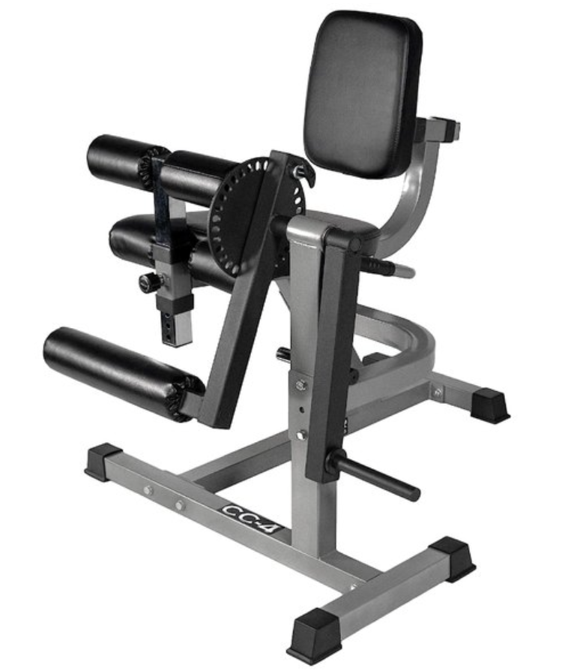
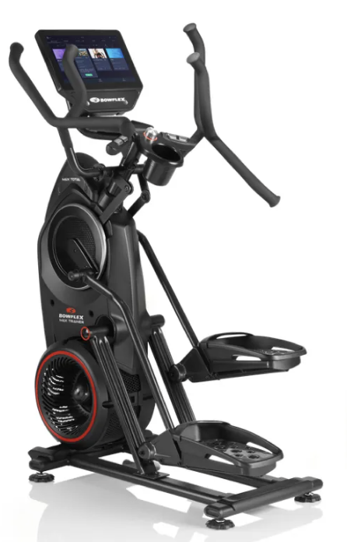
Summary
Better Fitness, Inc. (BFI) has designed two innovative universal weight machines, BodyPlus 100 and BodyPlus 200, with unique capabilities for the home exercise market. The recent trade show generated significant dealer interest, resulting in more orders than the company's current production capabilities. BFI now faces the challenge of efficiently producing these machines, each requiring different resources. BFI needs to optimize production within resource constraints, considering costs and market pricing.

Slide 5
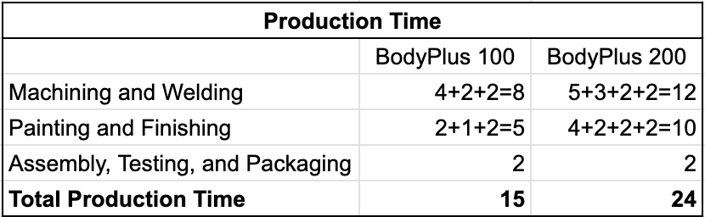
Problem Breakdown
Production Requirements:
BodyPlus 100: Frame, press station, and pec-dec station.
BodyPlus 200: Frame, press station, pec-dec station, and leg-press station.
Time Constraints:
Machining, welding, painting, and finishing times vary for each component.（600）
Assembly, testing, and packaging times are common for both machines.（450）
Raw material Costs:
Frame
Press Station
Pec-dec Station
Leg-press Station
Labor Costs:
Labor costs per hour for machining, welding, painting, finishing, and assembly.
Market and Pricing:
$2400 for BodyPlus 100 & $3500 forBodyPlus 200.
Dealers purchase at 70% of suggested retail price.
Production Goal:
President's directive to produce a minimum of 25% BodyPlus 200 units.

Slide 6
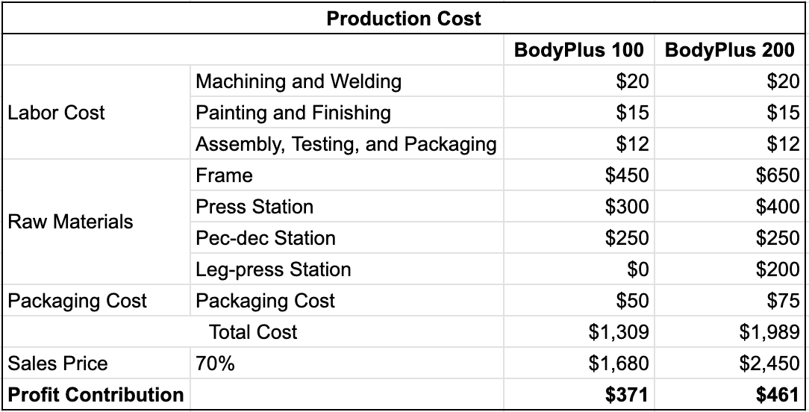
Problem Breakdown
Since overhead and shared costs must be deducted from total revenue before arriving at net profit.
Therefore, in this case, we choose to maximize profit rather than revenue by using profit contribution as the coefficient.

Slide 7
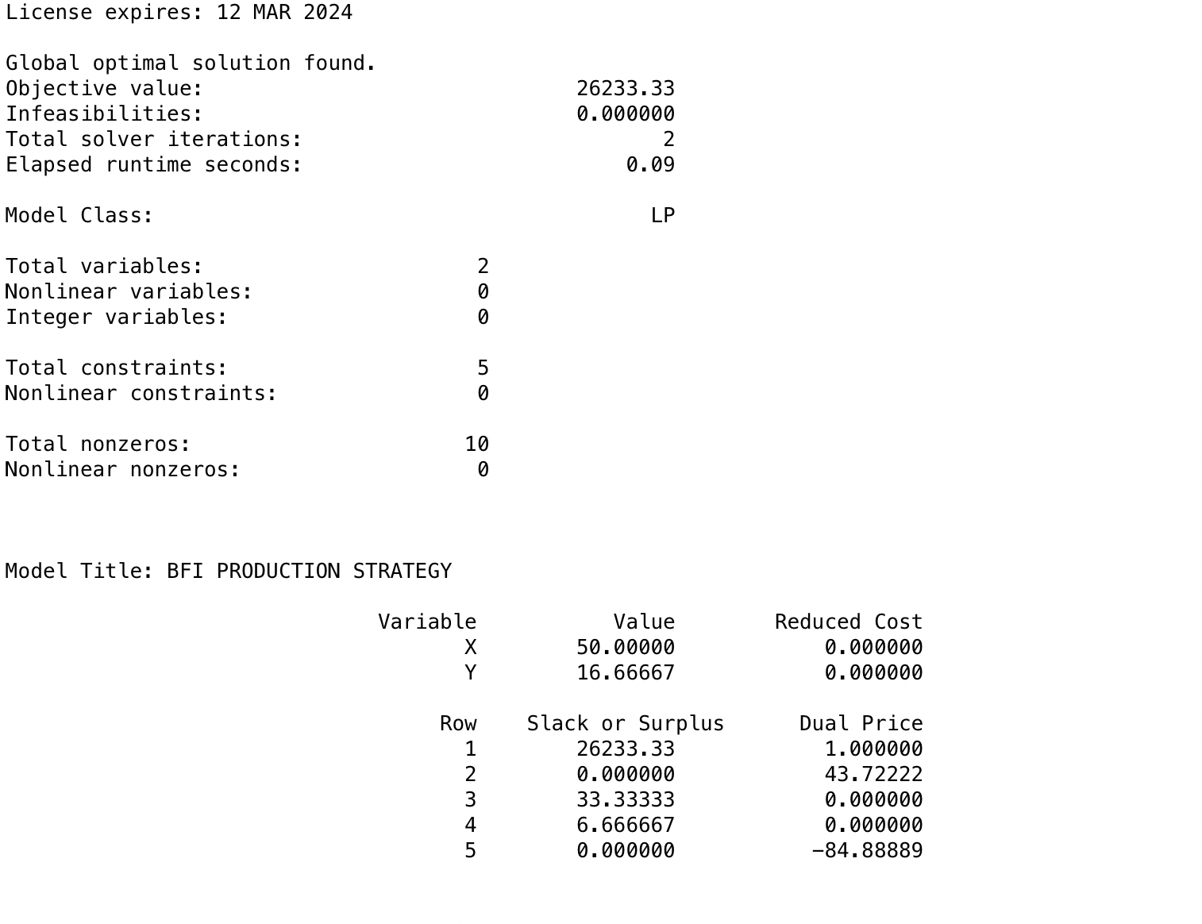
Linear Program
Based on the information we have, the linear program should be as follows:
Max 371*X + 461*Y
S.t.
(4+2+2)*X + (5+3+2+2)*Y <= 600
(2+1+2)*X + (4+2+2+2)*Y <= 450
2*X + 2*Y <= 140
Y >= 0.25*(X +Y)

Slide 8
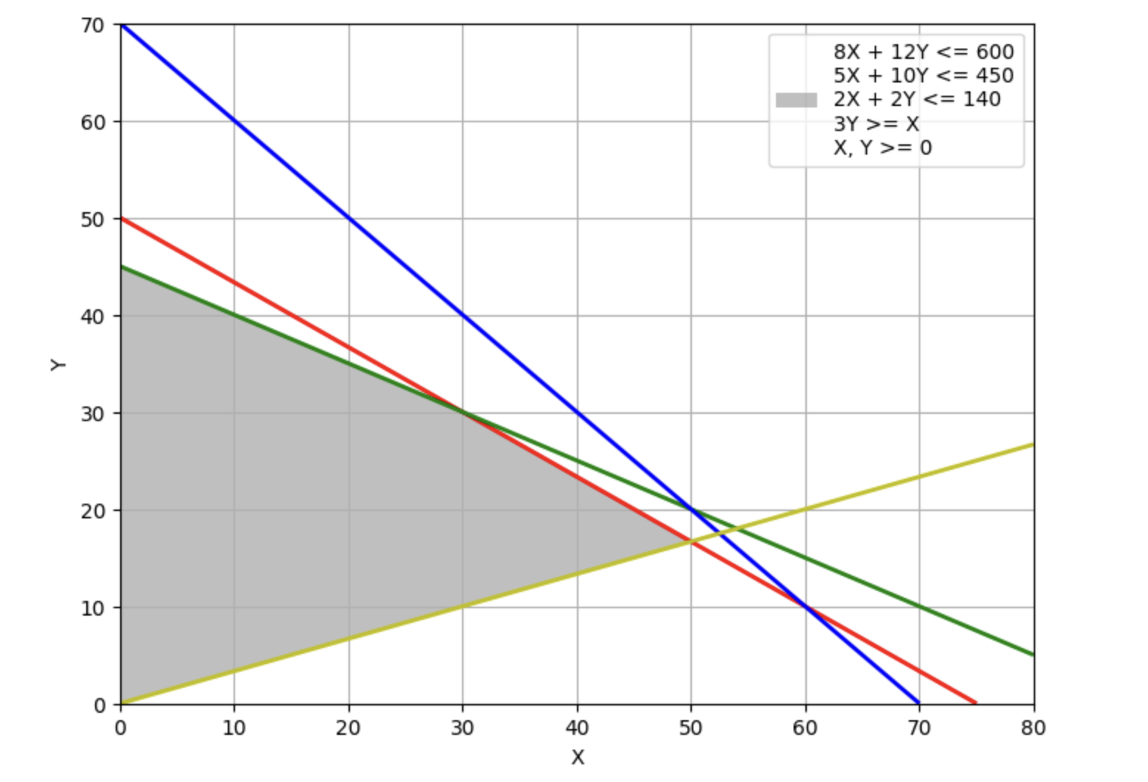
Graphical Solution
(4+2+2)*X + (5+3+2+2)*Y <= 600
(2+1+2)*X + (4+2+2+2)*Y <= 450
2*X + 2*Y <= 140
Y >= 0.25*(X +Y)
X, Y >= 0
1) + 4) -> (50, 50/3)
1) + 2) -> (30, 30)
4) + 5) -> (0, 0)
2) + 5) -> (0, 45)
Once get the 4 intersection points, we can calculate the values of Max 371*X + 461*Y
371*50 + 461*50/3 = 26233.33
371*30 + 461*30 = 24960
371*0 + 461*0 = 0
371*0 + 461*45 = 20745
Max 371*X + 461*Y
= Max(26233.33, 24960, 0, 20745) = 26233.33

Slide 9
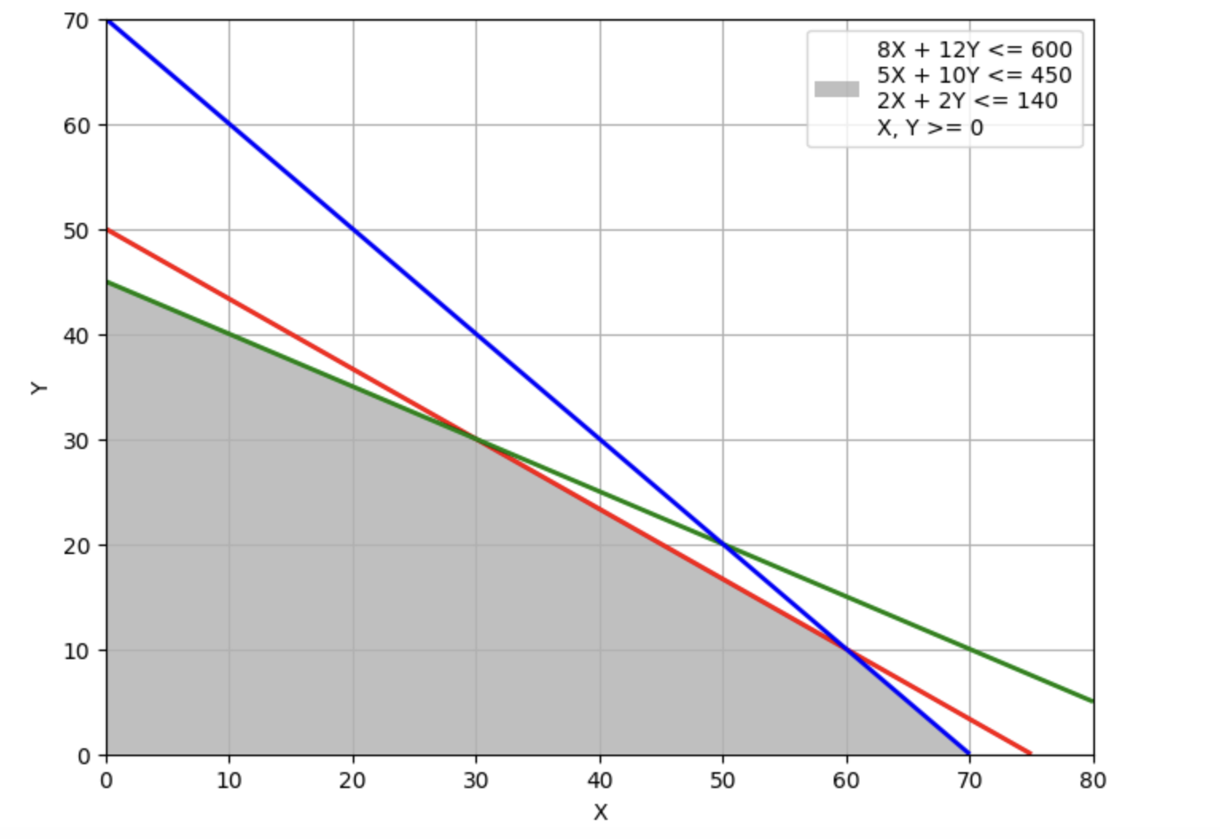
Graphical Solution
(0, 45)
(30, 30)
(60, 10)
(70, 0)
(0, 0)
Once get the 4 intersection points, we can calculate the values of Max 371*X + 461*Y
371*0 + 461*45 = 20745
371*30 + 461*30 = 24960
371*60 + 461*10 = 26870
371*70 = 25970
371*0 + 461*0 = 0
Max 371*X + 461*Y
= Max(20745, 24960, 26870, 25970, 0) = 26870

Slide 10
Increase Profitability
Strategy 1: Increase the coefficient of objective function
Max 371*X + 461*Y
Which means to increase the profit for selling each product.
There are four different method to achieve the goal.
We notice that the coefficient of objective function depends on the following:
Labor Cost
Raw Materials Cost
Packaging Cost
Sales Price

Slide 11
Increase Profitability
Strategy 2: Change the RHS value of constraints
There are four different constraints we could change:
(4+2+2)*X + (5+3+2+2)*Y <= 600 (Machining and welding time)
(2+1+2)*X + (4+2+2+2)*Y <= 450 ( Painting and finishing time)
2*X + 2*Y <= 140 (assembly, testing, and packaging time)
Y >= 0.25*(X +Y) (Number of units of the BodyPlus 200 must be produced)
However, Based on the dual value by lingo, the best way to increased profit is increase the Machining and welding time.

Slide 12

Conclusion
In Conclusion, BFI should produce 60 of BodyPlus 100 and 10 of BodyPlus 200 to reach the maximize profit $26,780.
With the Minimum Production Requirement for BodyPlus 200, BFI should produce 50 of BodyPlus 100 and 16 of BodyPlus 200 to reach the maximize profit $26,233.33.
To increase profit, BFI should increase the profit for selling each product. And increase the Machining and welding time.

Slide 13
Case 2
Case Title: R.C.Coleman
Chapter: 9
Chapter Title: Project Scheduling: PERT/CPM

Slide 14

Summary
The document is a case study about R. C. Coleman, a company that distributes a variety of food products. The case focuses on the company's decision to automate its warehouse operation by installing a computer-controlled order-picking system and a conveyor system. This automation project is led by the director of material management, who has compiled a list of activities for the project along with their optimistic, most probable, and pessimistic times.

Slide 15
Problem Breakdown
Current Warehouse Inefficiencies: The manual order-picking process is labor-intensive and less productive. Automation is deemed necessary to enhance efficiency.
Project Complexity: The project involves numerous interdependent activities with varying completion time estimates (optimistic, most probable, pessimistic).
Resource Allocation: Allocating resources effectively to critical activities is crucial to meet project deadlines.
Required Completion Time: Top management has set a stringent requirement for a 40-week project completion time.
Uncertainty: The variability in activity completion times introduces uncertainty, impacting the project's ability to meet deadlines.
Risk Management: The project manager must assess and mitigate risks to ensure successful implementation.
Cost Considerations: Crashing activities to expedite the project comes with additional costs, necessitating a cost-effectiveness analysis.

Slide 16
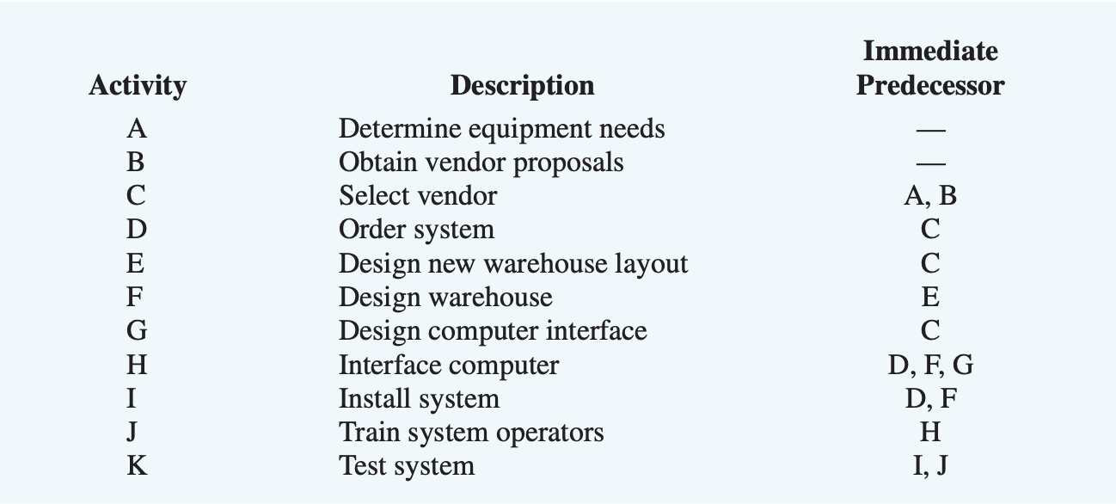
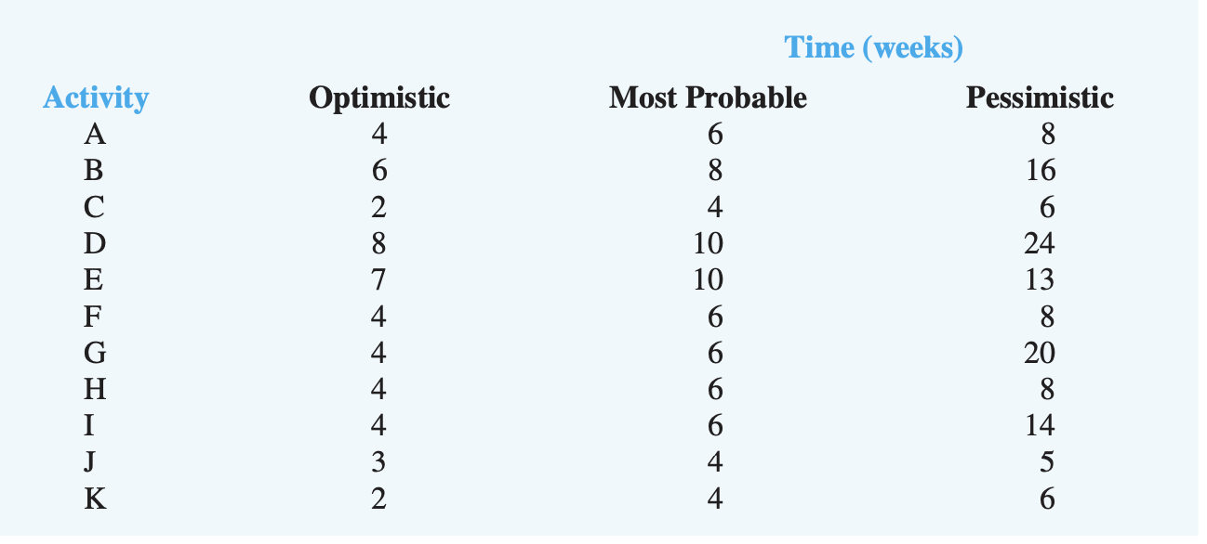
Given,
Each activity’s description, their immediate predecessors and weekly time required to complete these activities considering Optimistic, Most probable and Pessimistic approach.

Slide 17
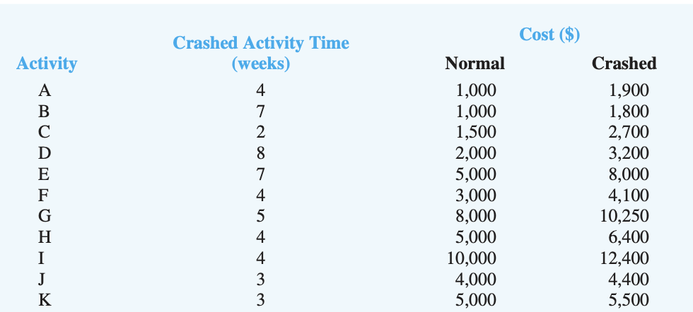
Given,
Each activity's crash time along with cost related to these activities during normal and crashed conditions.

Slide 18
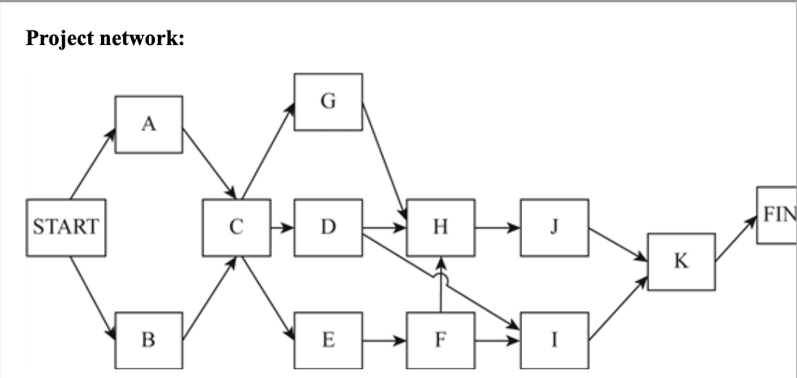
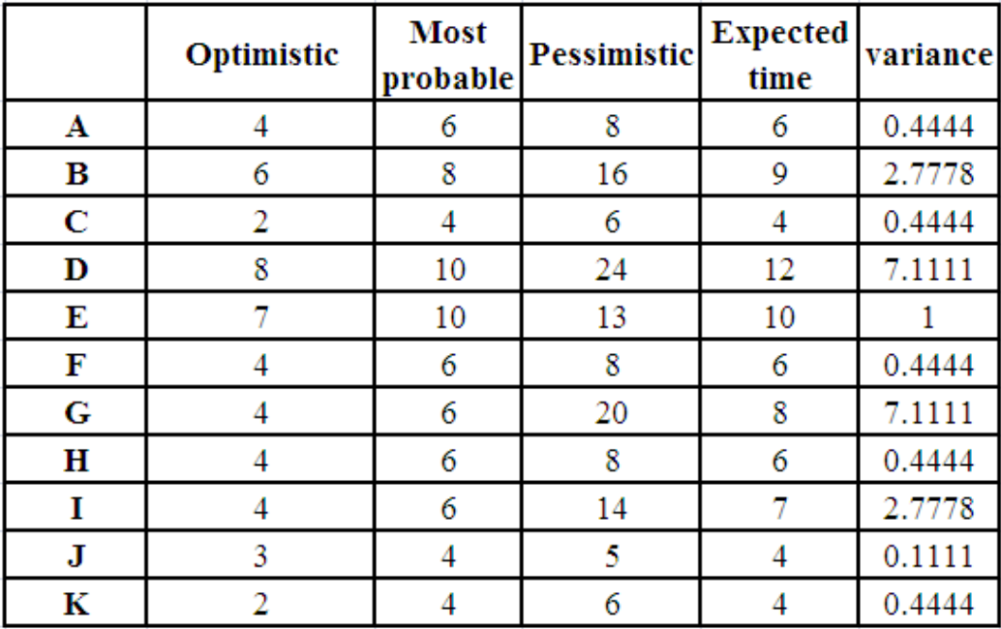
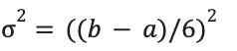
Solution:
With the help of what’s given, we created a basic project network. Also, calculated expected time :
t=(a+4m+b)/6
Where:
Optimistic time a = the minimum activity time if everything progresses ideally
Most probable time m = the most probable activity time under normal conditions
Pessimistic time b = the maximum activity time if substantial delays are encountered
and variance :

Slide 19
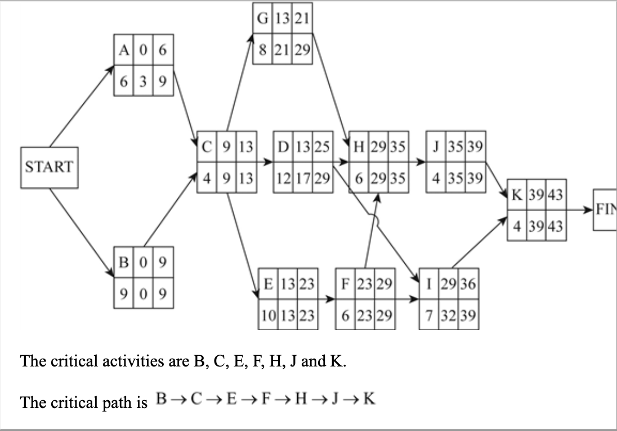
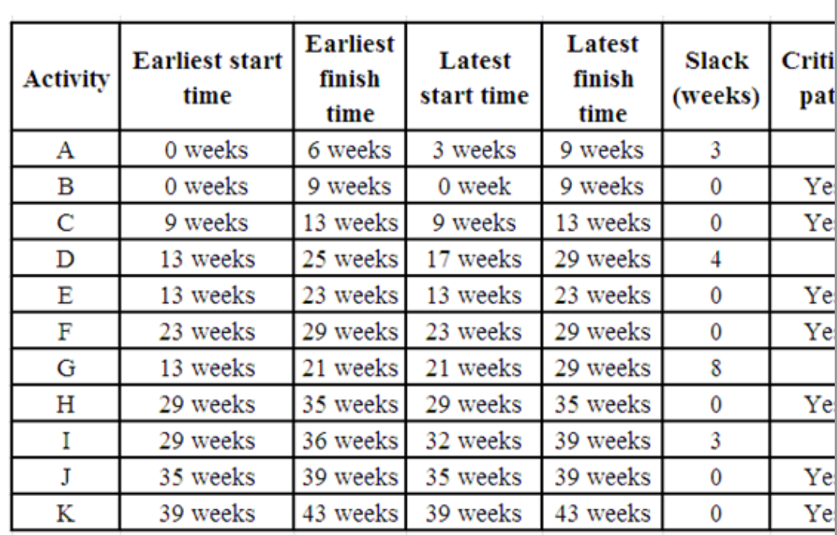
After Calculating Earliest Start time, Earliest Finish Time, Latest Start Time and Latest Finish time, this is the final network diagram, along with the table depicting critical path in competing this project.
Projected time = 9+4+10+6+6+4+4 = 43 weeks
Hence, the Expected Project Completion Time:
43 weeks
The variance of the critical path: 2.778 + 0.444 + 1.00 + 0.444 + 0.444 + 0.111 + 0.444= 5.67
And standard deviation is sqrt(5.67) =2.3804

Slide 20
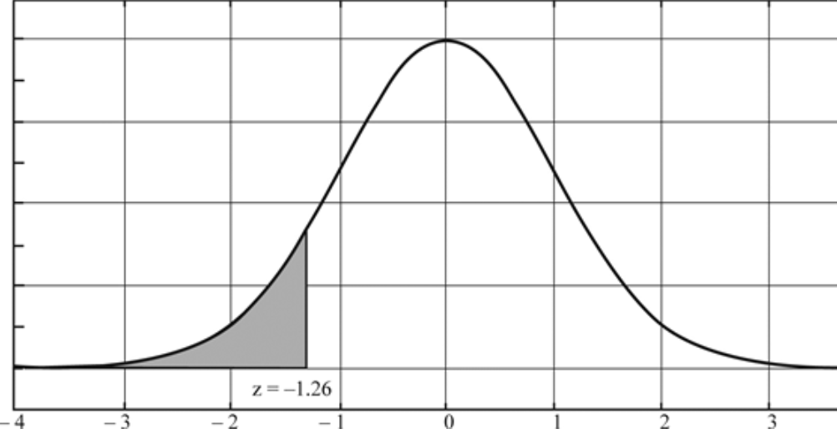
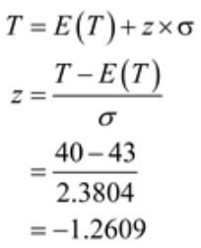
Managerial Needs
R. C. Coleman's top management established a required 40-week completion time for the project. Can this completion time be achieved? Include probability information in your discussion. What recommendations do you have if the 40-week completion time is required?
For this, we will Calculate the z value for T = 40 weeks, given the expected project completion time is 43 weeks and the standard deviation = 2.3804 using the formula:
In the normal distribution curve, the area left of the point marked z=-1.2609 is the probability that the project can be completed in 40 weeks. Reading from the normal distribution table, this area is 0.1038 or 10.38% of the total area .
The management has to be informed that there is only a 10% probability that the project can be completed in 40 weeks.
Recommendation : According to the calculations, Coleman should consider crashing project activities,
even if it's a low chance.

Slide 21
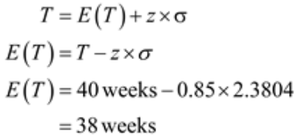
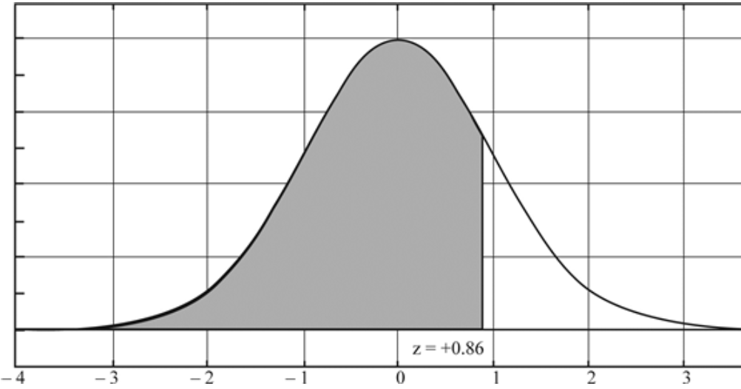
Managerial Needs
For this, we will calculate the E(t) value using the formula:
Suppose that management requests that activity times be shortened to provide an 80% chance of meeting the 40-week completion time. If the variance in the project completion time is the same as founded before, how much should the expected project completion time be shortened to achieve the goal of an 80% chance of completion within 40 weeks?
Therefore, the company should crash some of the activities, so that the expected project completion time can be shortened by 5 weeks. In other words instead of 43 weeks, the project can to be completed in 38 weeks.

Slide 22
Managerial Needs
Crashing activities involves spending additional resources (cost) to reduce their duration. To make a decision on which activities to crash, Lets calculate the cost per week saved for each activity and prioritize based on the cost-to-time ratio.
Maximum possible reduction in time,Mj:
Mj= xi - yi
xi = the completion time for activity i
yi = the amount of crash time for activity i
Crash cost per unit of time,Kj:
Kj= (Bi - Ai)/ Mj
Ai=cost for activity i
Bi= cost for activity I under max crashing
Hence, calculating for A :
Mj = 6-4 =2
Kj = (1900-1000)/2
= 450
Using the expected activity times as the normal times and the following crashing information, determine the activity crashing decisions and revised activity schedule for the warehouse expansion project:

Slide 23
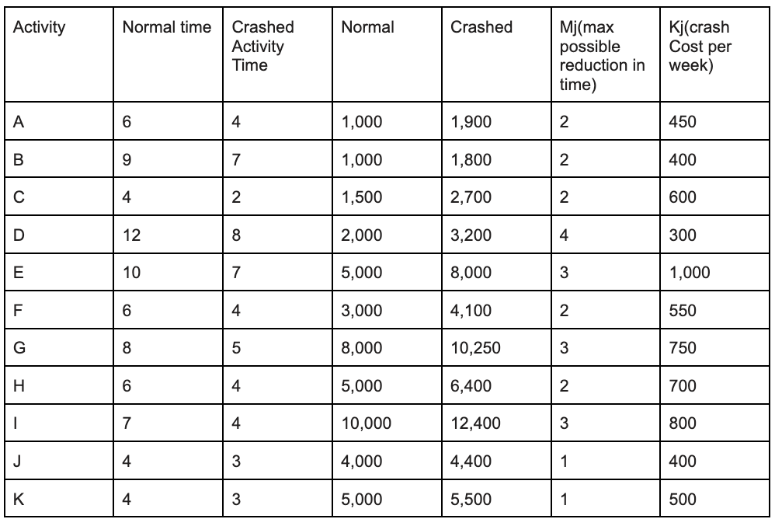
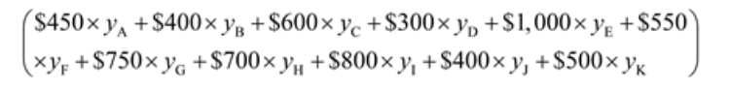
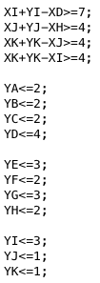
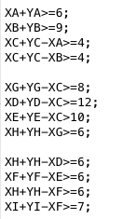
Managerial Needs
Therefore, the objective function is minimize :
Constraints :
Following Finish time >= Earliest start time + Activity time, we have :
The objective function would be to minimize the cost of crashing so that the project can be completed in 38 weeks instead of 43 weeks.
Denote the completion time of ith activity as Xi;
Denote the amount of weeks crashed as Yi.

Slide 24
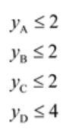
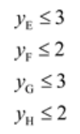
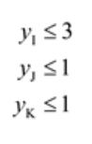
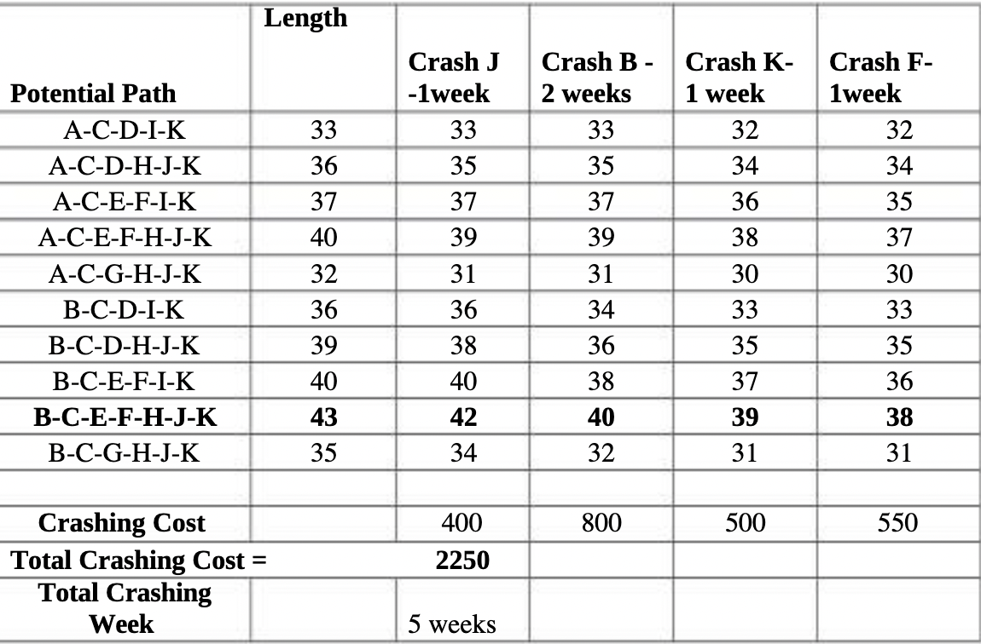
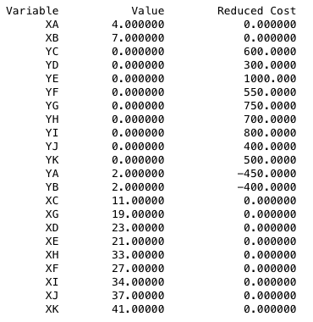
Managerial Needs
The total expected time to complete the project is 43 weeks, and the chance of 80%
completion is 38 weeks. The difference is for five weeks, and the project cannot be crashed
for more than five weeks.
From inspection of the crashing cost per week in the critical path, B →C →E→F→H→J→K, it is also apparent that the cheapest alternative is to crash 2 weeks of activity B, crash one week of activity F, crash one week of activity J and crash one week of activity K.
Additional constraints are the maximum crashing possible for each activity
All x and y values are >=0
Using lingo:

Slide 25
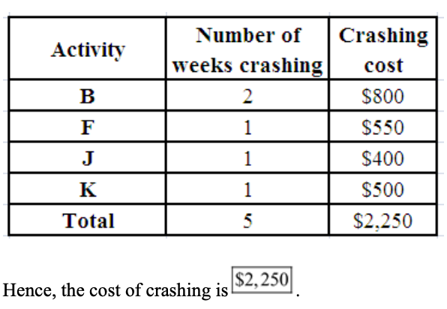
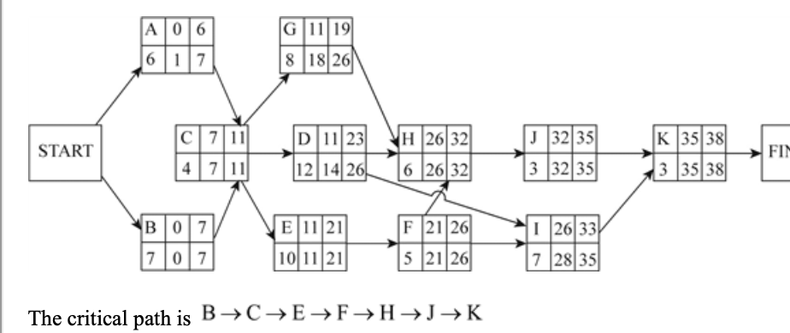
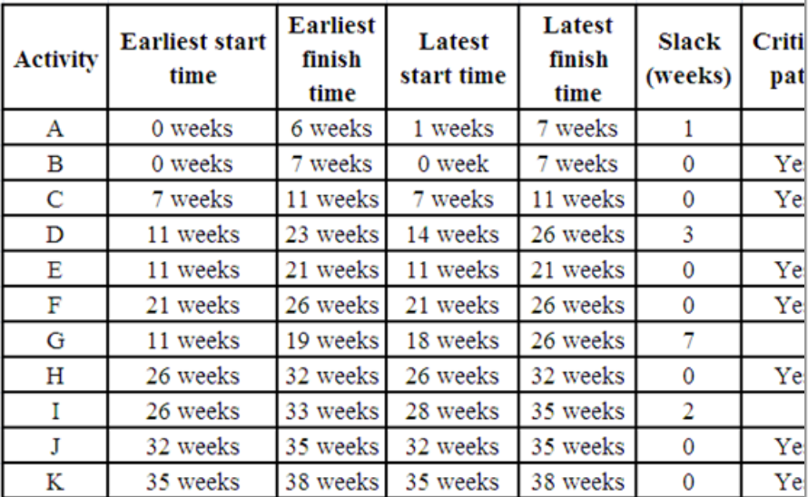
Managerial Needs
The expected project completion time (t) = 7 weeks + 4 weeks +10 weeks + 5 weeks + 6 weeks + 3 weeks + 3 weeks = 38 weeks Final Conclusion : Project Completion Time is 43 weeks, which is more than the required 40 week completion time. To complete the project within 38 weeks ( 80% chance), the project activities have to be crashed by five weeks at a total of $2250 on activities J (training system operators), B( Obtaining vendor proposals ), K( testing the system) and F( designing the warehouse) respectively

Slide 26
Thank you for Listening !!

